Slide 1
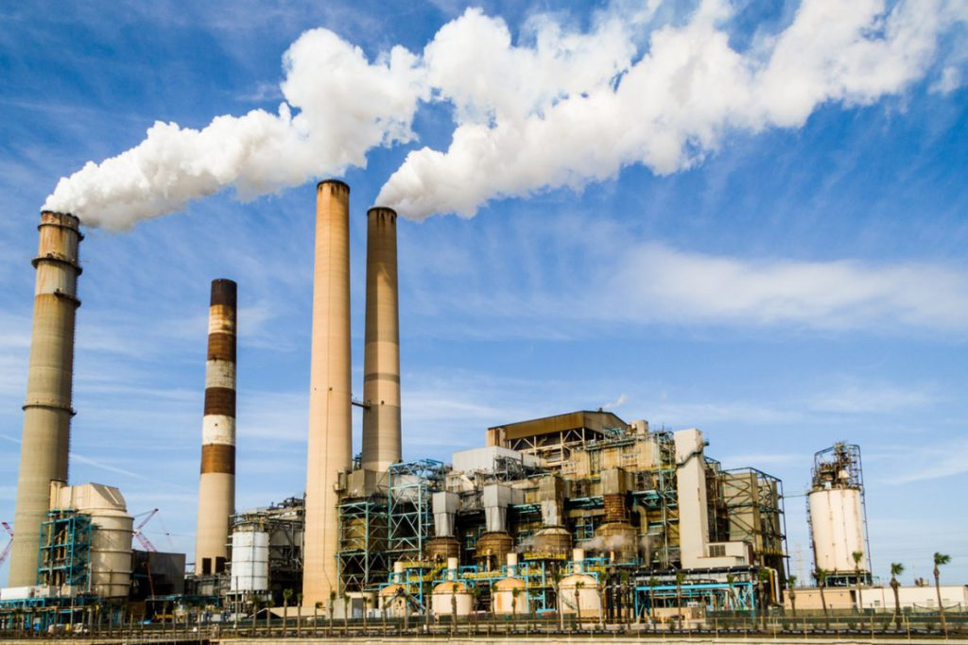
Air Quality Prediction with different Regression Method
Notes:
© Copyright Showeet.com – Creative & Free PowerPoint Templates

Slide 2
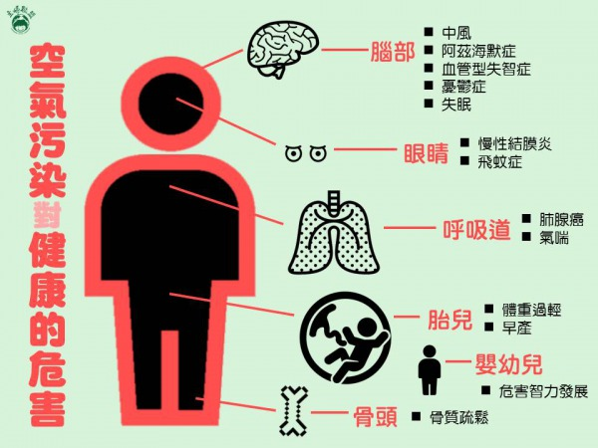
Proposal
04
Notes:
© Copyright Showeet.com – Creative & Free PowerPoint Templates

Slide 3
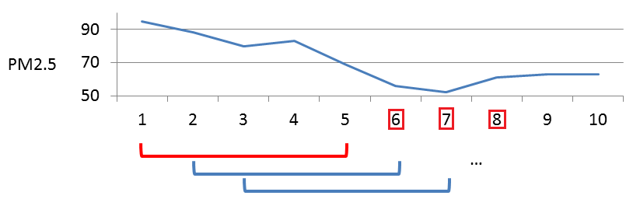
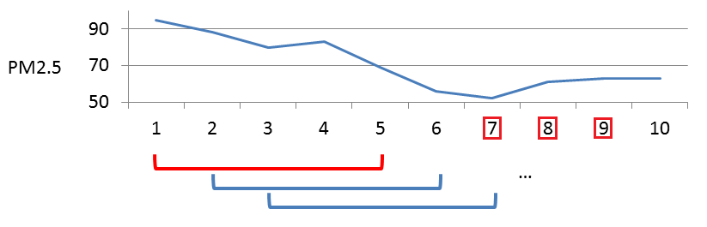
Training Example
04
Notes:
© Copyright Showeet.com – Creative & Free PowerPoint Templates

Slide 4
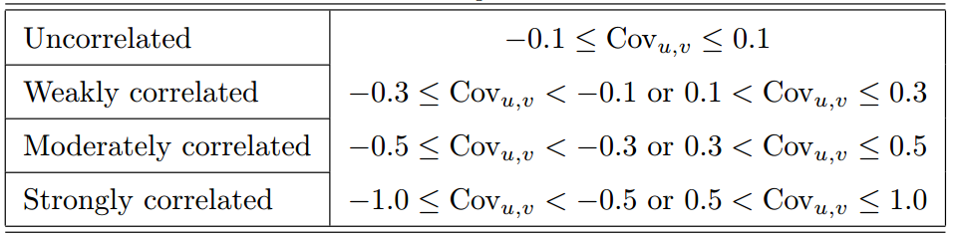
Correlation Analysis
04
O3: humidity, NOX, NO2.
SO2: None.
CO: NOX, NO, NMHC, NO2, CH4, THC.
NO2: NOX, O3, CO, NMHC, THC.
PM2.5: PM10.
PM10: PM2.5.
Notes:
© Copyright Showeet.com – Creative & Free PowerPoint Templates

Slide 5
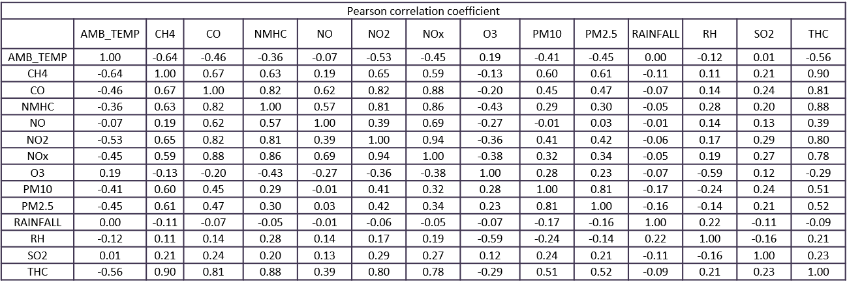
Correlation Analysis
04
Notes:
© Copyright Showeet.com – Creative & Free PowerPoint Templates

Slide 6
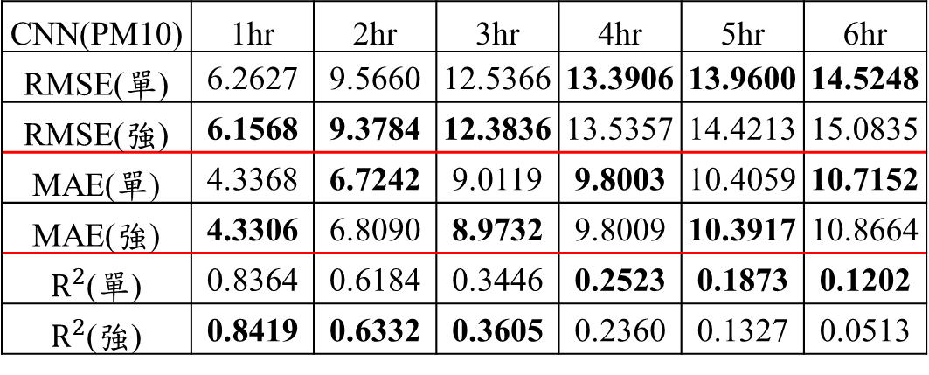
相關性分析探討
05
CNN(PM10) | 1hr | 2hr | 3hr | 4hr | 5hr | 6hr
RMSE(單) | 6.2627 | 9.5660 | 12.5366 | 13.3906 | 13.9600 | 14.5248
RMSE(強) | 6.1568 | 9.3784 | 12.3836 | 13.5357 | 14.4213 | 15.0835
MAE(單) | 4.3368 | 6.7242 | 9.0119 | 9.8003 | 10.4059 | 10.7152
MAE(強) | 4.3306 | 6.8090 | 8.9732 | 9.8009 | 10.3917 | 10.8664
$R^{2}$(單) | 0.8364 | 0.6184 | 0.3446 | 0.2523 | 0.1873 | 0.1202
$R^{2}$(強) | 0.8419 | 0.6332 | 0.3605 | 0.2360 | 0.1327 | 0.0513
Notes:
© Copyright Showeet.com – Creative & Free PowerPoint Templates

Slide 7
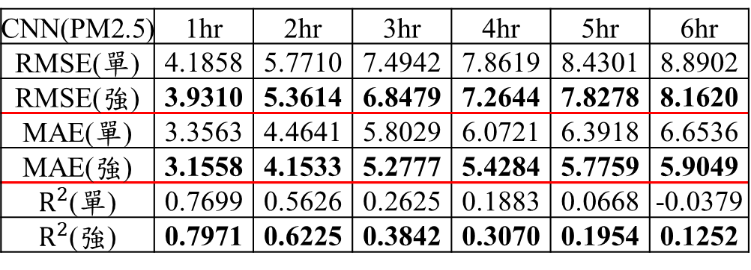
相關性分析探討
05
CNN(PM2.5) | 1hr | 2hr | 3hr | 4hr | 5hr | 6hr
RMSE(單) | 4.1858 | 5.7710 | 7.4942 | 7.8619 | 8.4301 | 8.8902
RMSE(強) | 3.9310 | 5.3614 | 6.8479 | 7.2644 | 7.8278 | 8.1620
MAE(單) | 3.3563 | 4.4641 | 5.8029 | 6.0721 | 6.3918 | 6.6536
MAE(強) | 3.1558 | 4.1533 | 5.2777 | 5.4284 | 5.7759 | 5.9049
$R^{2}$(單) | 0.7699 | 0.5626 | 0.2625 | 0.1883 | 0.0668 | -0.0379
$R^{2}$(強) | 0.7971 | 0.6225 | 0.3842 | 0.3070 | 0.1954 | 0.1252
Notes:
© Copyright Showeet.com – Creative & Free PowerPoint Templates

Slide 8
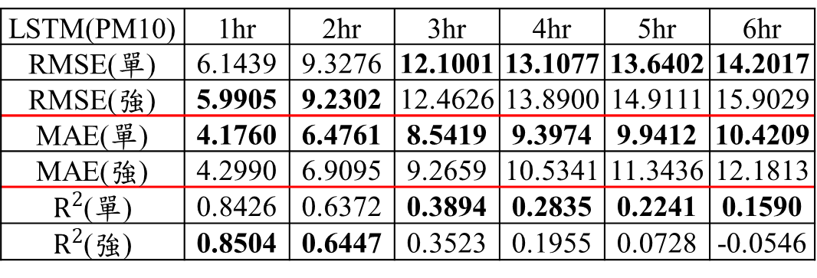
相關性分析探討
05
LSTM(PM10) | 1hr | 2hr | 3hr | 4hr | 5hr | 6hr
RMSE(單) | 6.1439 | 9.3276 | 12.1001 | 13.1077 | 13.6402 | 14.2017
RMSE(強) | 5.9905 | 9.2302 | 12.4626 | 13.8900 | 14.9111 | 15.9029
MAE(單) | 4.1760 | 6.4761 | 8.5419 | 9.3974 | 9.9412 | 10.4209
MAE(強) | 4.2990 | 6.9095 | 9.2659 | 10.5341 | 11.3436 | 12.1813
$R^{2}$(單) | 0.8426 | 0.6372 | 0.3894 | 0.2835 | 0.2241 | 0.1590
$R^{2}$(強) | 0.8504 | 0.6447 | 0.3523 | 0.1955 | 0.0728 | -0.0546
Notes:
© Copyright Showeet.com – Creative & Free PowerPoint Templates

Slide 9
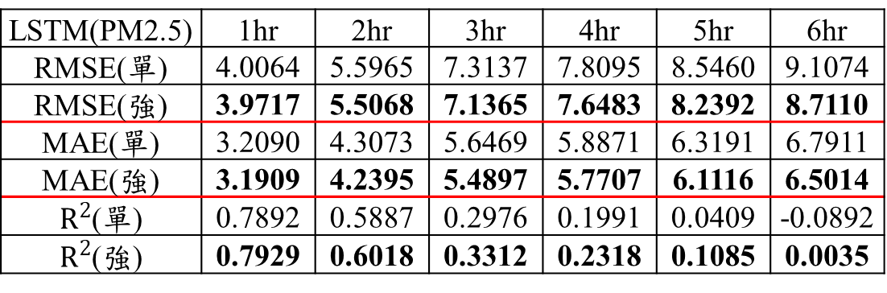
相關性分析探討
05
LSTM(PM2.5) | 1hr | 2hr | 3hr | 4hr | 5hr | 6hr
RMSE(單) | 4.0064 | 5.5965 | 7.3137 | 7.8095 | 8.5460 | 9.1074
RMSE(強) | 3.9717 | 5.5068 | 7.1365 | 7.6483 | 8.2392 | 8.7110
MAE(單) | 3.2090 | 4.3073 | 5.6469 | 5.8871 | 6.3191 | 6.7911
MAE(強) | 3.1909 | 4.2395 | 5.4897 | 5.7707 | 6.1116 | 6.5014
$R^{2}$(單) | 0.7892 | 0.5887 | 0.2976 | 0.1991 | 0.0409 | -0.0892
$R^{2}$(強) | 0.7929 | 0.6018 | 0.3312 | 0.2318 | 0.1085 | 0.0035
Notes:
© Copyright Showeet.com – Creative & Free PowerPoint Templates

Slide 10
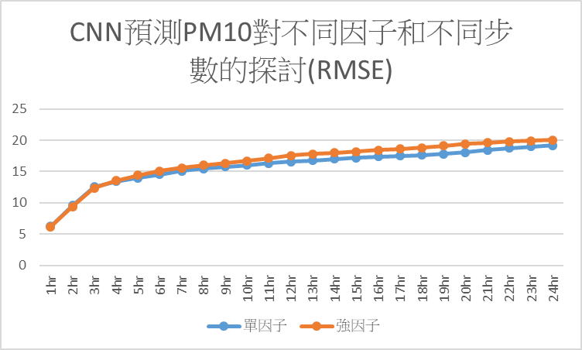
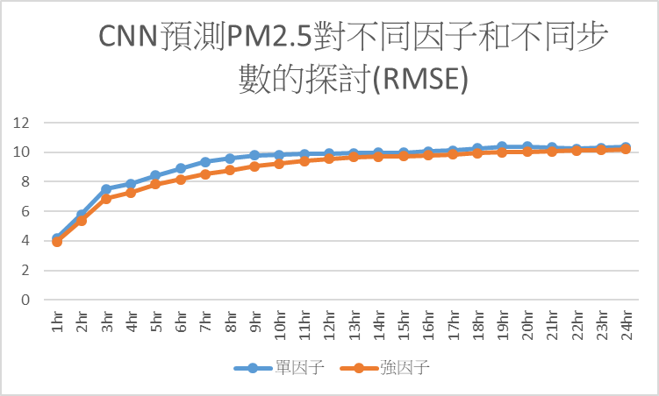
相關性分析探討
05
Notes:
© Copyright Showeet.com – Creative & Free PowerPoint Templates

Slide 11
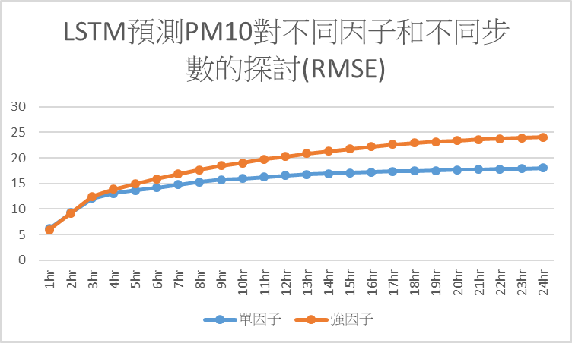
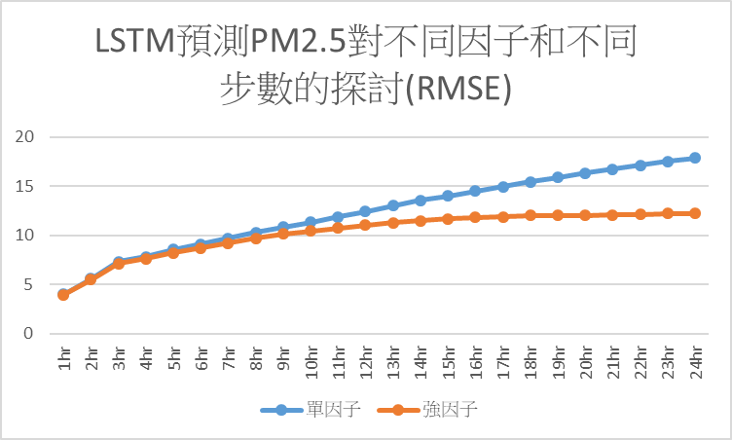
相關性分析探討
05
Notes:
© Copyright Showeet.com – Creative & Free PowerPoint Templates

Slide 12
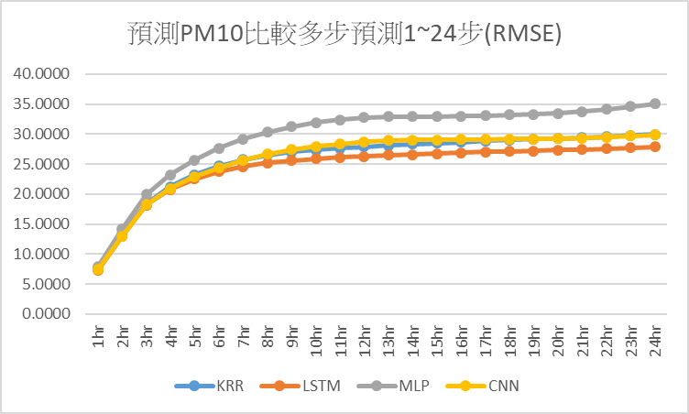
不同模型之預測效果比較
05
Notes:
© Copyright Showeet.com – Creative & Free PowerPoint Templates

Slide 13
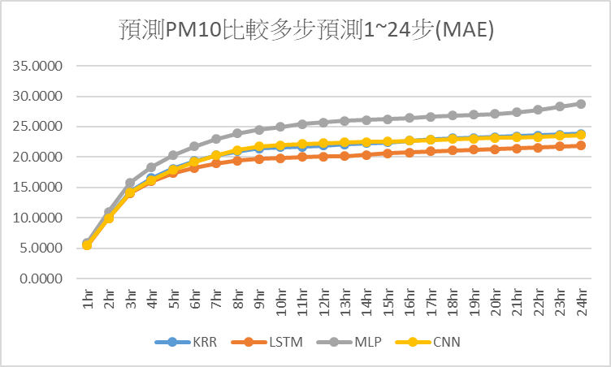
不同模型之預測效果比較
05
Notes:
© Copyright Showeet.com – Creative & Free PowerPoint Templates

Slide 14
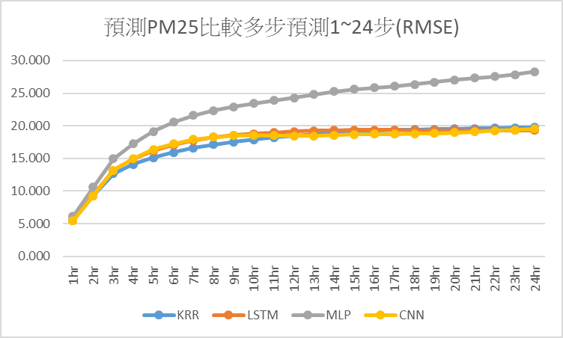
不同模型之預測效果比較
05
Notes:
© Copyright Showeet.com – Creative & Free PowerPoint Templates

Slide 15
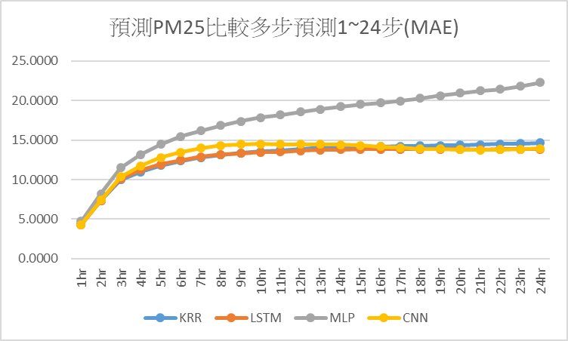
不同模型之預測效果比較
05
Notes:
© Copyright Showeet.com – Creative & Free PowerPoint Templates

Slide 16
Thank You !
Notes:
© Copyright Showeet.com – Free PowerPoint Templates

